Slide 1



Meet the Teacher Evening
Ladybird Class – 2025-2026

Slide 2
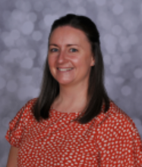
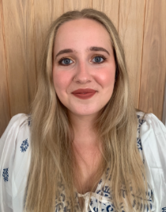
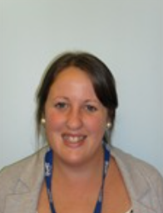
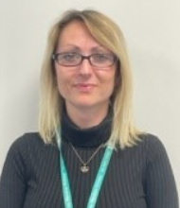
Meet the team…
Mrs Keylock
Class teacher
Miss Dannan
Teaching
Assistant
Ms Salt
Teaching Assistant
Mrs Sims
Tuesday pm

Slide 3

Our School Values

Slide 4
Our Curriculum
We use the National Curriculum and the following schemes are a platform to enhance the learning:
Maths
Power Maths (WRM Edition)
English
Bookwrites
Spelling
Read Write Inc Spelling
Science
WeST Science
Reading
RWInc Whole Class Reading, Accelerated Reader and individual reading sessions
PE
imoves
Computing
Purple Mash
Art/DT
Access Art
PSHE
Jigsaw Scheme
RE/History/Geography
Music
Sing Up!

Slide 5
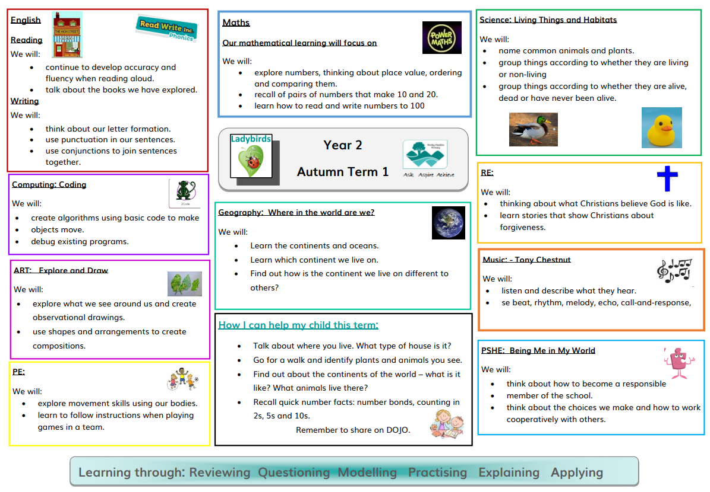
Our curriculum this term

Slide 6
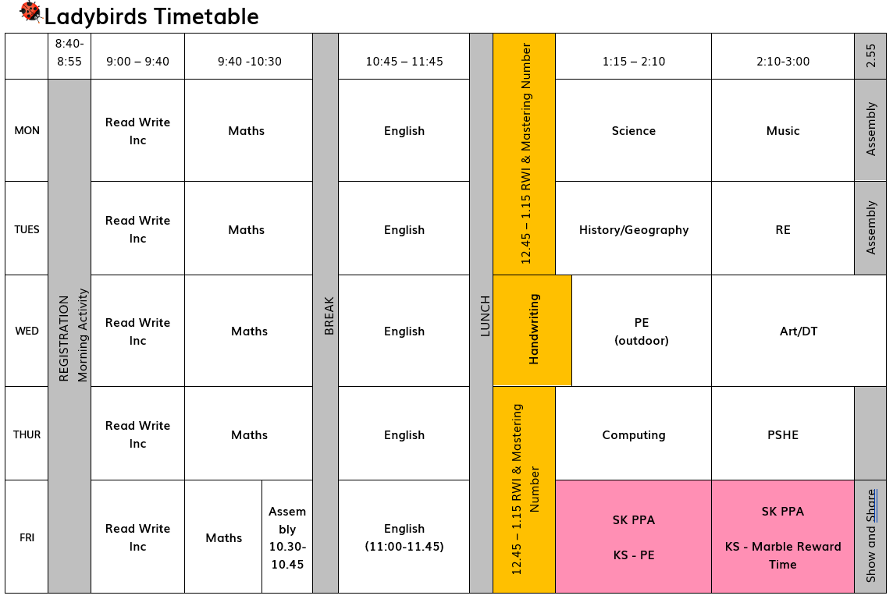
Our Timetable

Slide 7
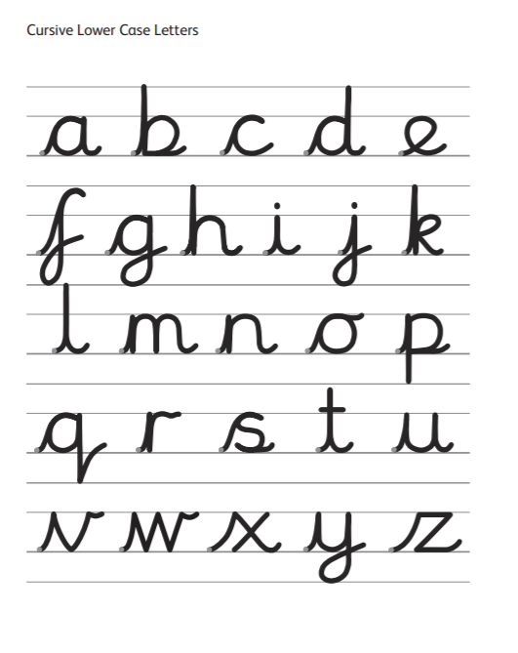
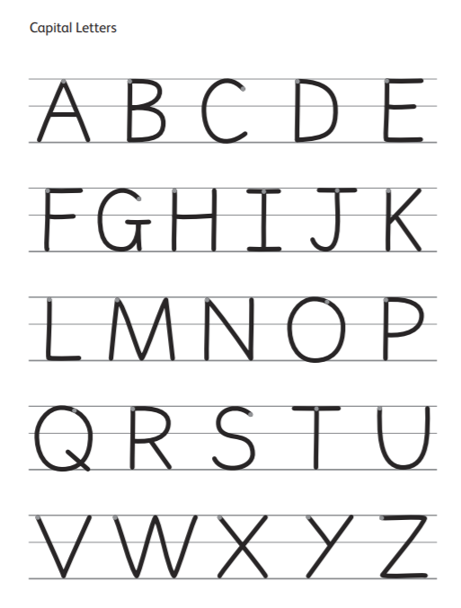
Handwriting

Slide 8

Reading
Read Write Inc (RWI) is used to ensure that all children have decodable books that match their stage.
Each week the children will bring home the books they have been using in lessons, a book bag book and a library book to be shared with them.
As a school DOJO is used as a reading record.
Please post in portfolios or on a message when your child has read and completed a book. We can then celebrate this with them and change books accordingly.
It is important that books are not only read once but several times to ensure fluency and opportunities to talk about what they have read.

Slide 9


Reading books /Accelerated Reader
In Year 2, we introduce the Accelerated Reader programme once they are ready.
At this time their library book will become their reading book.
This information will be shared on Dojo.

Slide 10

Reading
At the start of the term, children will complete an online ‘Star test’ to determine their reading level. Whilst this is often an improvement in reading progress from test to test, this is not always the case, especially for infrequent readers and following a break from learning.
Books will be chosen that are at the correct level for the child. At the end of each book, children will complete a quiz to determine how well the text has been understood.
When the book has been read, parents are asked to post on their child’s Classdojo portfolio stating that they are ready to quiz.
For shorter books, it may be beneficial to read the book more than once to embed the content; one weekly quiz with a well understood book is better than 5 poor quiz results.
Reading books should be in school every day.

Slide 11

Spelling
In Year 2, the children will start the year revising the Common Exception Words for year 1 and high frequency words before moving onto the year 2 words. They will have 5 words to practice at home during the week.
During the year the children will move onto the RWI Spelling programme. They will have a spelling log that will be taken to and from school to help learn the spellings over the week.
Spelling Shed is also used at home to support spellings.
EdShed

Slide 12
Homework
Reading
Daily. Please use the Class Dojo portfolios to report when your child has read. (Photos / videos are optional a message is acceptable)
Spelling
Spelling Shed is used to practice weekly spellings.
Maths
A recall fact that will support the maths learning in class.
Power maths games

Slide 13




Access to Power Maths activities (that are linked to current learning) will be introduced to allow children to reinforce Maths knowledge at home.
Mastering Number is used to support basic number fluency and rapid subitising.
Children will move on to Times Table Rockstars as appropriate to their progression.
There will be Maths homework every week!
White Rose Maths ‘app’ activities will also be available online to support Maths fluency and practice.

Slide 14
Daily Routines…
Classroom doors open at 8:40am and a teacher/TA will welcome the children in.
Children put coats and lunchboxes in the cloakroom and bookbags go in lockers in the corridors.
Bring named water bottles with a secure lid with water in them. Please replace water daily.
There will be a morning break at 10:30-10:45
Lunch is 11:45 – 12:45
Children leave school at 15:20 and are to be collected by an adult from the door. (Any change in pick up please message the office or the class via DOJO)

Slide 15
PE
Children will change into their PE kit at school on the appropriate days.
Please ensure all items are labelled and in an appropriate bag. Earrings must be removed or taped over for PE.(Please provide your own tape.)
Wednesday | PE
Friday | PE

